Slide 1
Web Programming
Week 2 Logic & Algorithms

Slide 2

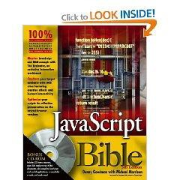
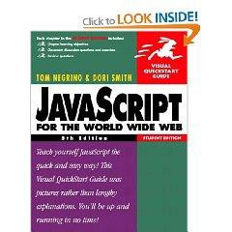
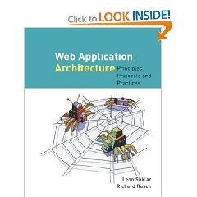
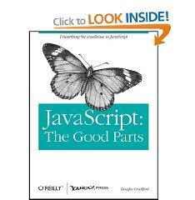

Resources
Plenty of online material
Module website here
W3schools: here
MDN JS Web Docs: here
Codecademy: here
W3S JS tutorial: here
no specific textbooks
University library
JavaScript here
DHTML here
HTML here

Slide 3
content today
Logical operators &&, ||, !
Associativity, Distribution & DeMorgan Laws
Truth table
Operator precedence
Switch-case-default-break, statement
switch (x){
case x1: stmt0; break;
case x2: stmt1; break;
...
default: defaultStmt;
}
Examples

Slide 4

Logical operators
• and (&&), or(||) and not (!)
operands are logical values : true, false
can be used to make more advanced tests for use in
conditionals and iteration.
Enter a number, output message if it is between [2,4].
var x=Number(prompt("enter a number: "));
alert(x>=2 && x<=4 );
//alert(!(x<2 || x>4)); console.log(x<2 || x>4)

Slide 5
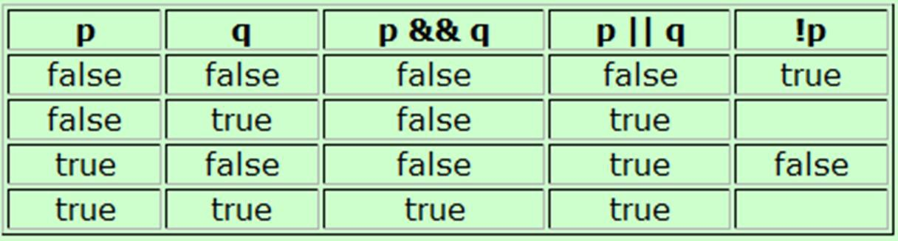
Truth table
A chart showing the results of a logical operator for all
possible values of its operands.
p&&q is only true, if both its operands are true
p||q is true, if either of its operands are true
alert(true && false); alert(true || false);

Slide 6
Logical operator rules
Associativity:
– p&&q == q&&p,
– p||q == q||p
just as x*y =y*x ; x+y = y+x
Distribution
– p && ( q || r ) == (p&&q) || (p&&r)
Just as x*(y+z) = x*y + x*z
– p || ( q && r ) == (p||q) && (p||r)
DeMorgan special rules
– !(p&&q) == !p || !q
– !(p||q) == !p && !q

Slide 7
JS operator precedence
Highest priority first row, equal
precedence within a row:
. (record), [ ] (array)
--, ++ (de/increment, post/prefix)
! (not) +, - (unary, prefix)
• / ,*, %
• + , - (binary, infix)
• < ,<=, > ,>=
• ==, !=, ===, !==
• &&
• ||
• = (assign), +=, -= ,*= ,/= ,%=
c <= 'z' && ! b || c
c <= 'z' && (! b) || c
(c <= 'z') && (! b) || c
((c <= 'z') && (! b)) || c

Slide 8
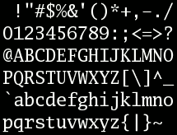
ASCII character
95 printable characters (codes 32 to 126)
start with "space" at 32
decimal digits 0-9 start at 48
26 upper case letters A-Z start at 65
26 lower case letters a-z start at 97

Slide 9
Try out: logical operators
Determine whether a character is lower case , letter, digit, vowel:
var c=prompt("enter a character:"); if( c>="a" && c<="z" )
alert("lower case letter");
if( c>="a" && c<="z" || c>="A" && c<="Z")
alert("letter");
if( "0"<=c && c<="9" )
alert("digit");
if( c=="a" || c=="e" || c=="i" || c=="o" || c=="u" ) alert("vowel");
4.1 - logical operators

Slide 10
Number systems
Decimal (base 10)
Ten fingers
Binary (base 2)
Fundamental number and logical system for computer
On and Off
Hexadecimal (base 16)
Binary numbers quickly become tedious to write.
Hexadecimal gives us a shorthand way to represent.

Slide 11
Decimal
Base: 10
• Digits: 0, 1, 2, 3, 4, 5, 6, 7, 8, 9
– Each digit in a decimal number is multiplied by 10^{n-1} where n is the column number, counting from right to left
10² | 10¹ | 10⁰
2 | 9 | 3
(2 * 10²) + (9 * 10¹) + (3 * 10⁰)
= 200 + 90 + 3
= 293

Slide 12
Binary
Base: 2
Digits: 0, 1
Each digit in a binary number is multiplied by
2^{n-1} (n is the column number, counting from right to left)
₂7 | ₂6 | ₂5 | ₂4 | ₂3 | ₂2 | ₂1 | ₂0
128 | 64 | 32 | 16 | 8 | 4 | 2 | 1
1 | 0 | 1 | 0 | 0 | 0
(1*2⁵)+(1*2³)
= 1x32+ 1x8 = 40

Slide 13
Hexadecimal
Dec | Hex | Binary
0 | 0 | 0000
1 | 1 | 0001
2 | 2 | 0010
3 | 3 | 0011
4 | 4 | 0100
5 | 5 | 0101
6 | 6 | 0110
7 | 7 | 0111
8 | 8 | 1000
9 | 9 | 1001
10 | A | 1010
11 | B | 1011
12 | C | 1100
13 | D | 1101
14 | E | 1110
15 | F | 1111
Base: 16
Digits: 0 ~9, A, B,
C, D, E, F
16³ | 16² | 16¹ | 16⁰
4096 | 256 | 16 | 1

Slide 14
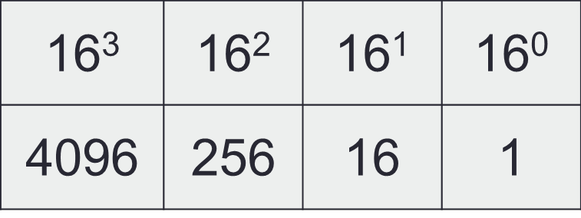
Exe: Convert Hex-number to decimal
The column headings are increasing powers of 16,
starting at 16⁰ on the right hand side.
A hexadecimal number: 2 3 E
The decimal equivalent :
(2x16²) + (3x16¹) + (14x16⁰) = 512 + 48 + 14 = 574
length−1

i =0
digVal *16
length−1−i
i
i index from left to right

Slide 15
Analysis steps
Step 1: Present in a genialised math formula,
derive roles from examples
length−1

i =0
digVal *16
length−1−i
i
i index from left to right
Step 2: get each elements, e.g. digVal
Step 3: consider functions, data structure, flow control in coding, e.g. sum, loop, power of Math obj.
Step 4: debug, pay attention to details and
possible errors, e.g. invalid inputs

Slide 16
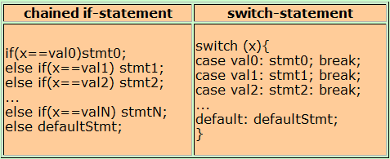
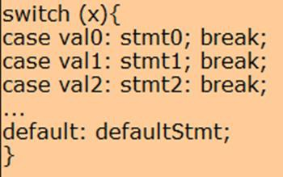
get digVal: Switch statement
switch-statement does not let you do anything that you could not do before
Stmt can be compound statements in {..;..;}.
break statement immediately terminates the compound statement in which it lies
4.2 - switch-statement, break-statement

Slide 17
Convert hex-digit to decimal (digVal)
var hex= prompt("Enter a hex-digit:");
var digVal;
switch(hex) {
case '0': digVal = 0; break;
case '1': digVal = 1; break;
….
case '9': digVal = 9; break;
case 'A': digVal = 10; break;
case 'B': digVal = 11; break; case 'C': digVal = 12; break; case 'D': digVal = 13; break; case 'E': digVal = 14; break; case 'F': digVal = 15; break;
default: digVal = "invalid Hex-digit";
}
alert('The decimal for the hex-digit is: ' + digVal);

Slide 18
Convert hex-digit to decimal (digVal)
var hex = prompt("enter a hexadecimal digit").toUpperCase(); var digVal;
switch(hex) {
case '0':
case '1’:
….
case '9': digVal = Number(hex); break;
case 'A': digVal = 10; break; case 'B': digVal = 11; break; case 'C': digVal = 12; break; case 'D': digVal = 13; break; case 'E': digVal = 14; break; case 'F': digVal = 15; break;
default: digVal = "invalid Hex-digit";
}
alert('The decimal number is: ' + digVal);

Slide 19
Convert Hex-number to decimal
var hexnum= prompt(“Enter a hex-number: ").toUpperCase();
var digVal,Dvalue=0; for(i in hexnum) {
hex=hexnum.charAt(i);
switch(hex) {
case "0": case "1": case "2": case "3": case "4":
case "5": case "6": case "7": case "8": case '9': digVal = Number(hex); break; case 'A': digVal = 10; break;
case 'B': digVal = 11; break; case 'C': digVal = 12; break; case 'D': digVal = 13; break; case 'E': digVal = 14; break; case 'F': digVal = 15; break;
default: digVal = "invalid Hex-digit";
}
if(digVal!="invalid Hex-digit“ )
Dvalue=Dvalue+(digVal*Math.pow(16,(hexnum.length-1-i)));
else {Dvalue="invalid Hex-number"; break;}
}
alert("Hex ="+hexnum+" Decimal ="+Dvalue);

Slide 20

summary: Iteration & conditionals
Loop:
for
do … while
while …
Array
Logical operators &&, ||, !
Lecture
Truth table
Operator precedence
switch (x){
case x1: stmt0; break;
...
default: defaultStmt;
}
Lab
Practice !
Logic thinking, math and algorithm

